Slide 1
Evacuating the Car-less Population of Chicago with Uber
Team A-4: Jessica Sun, Steffany Bahamon, Mo Ran, Jessica Heller, Emmanuel Darko
Notes:
Sun
Using a For profit corporation

Slide 2





The Inspiration: Airbnb
3000 Listings
No Booking Fees
NonProfits: All Hands Volunteers
Education: FEMA and Red Cross
U.S. Chamber of Commerce Foundation
Airbnb Disaster Relief Program
Notes:
Sun
Airbnb's Disaster Response Program
3000 Active Listings, Airbnb pays its hosts as part of Global Disaster Relief department
Partners: Relief Orgs such as All Hands Volunteers, a disaster relief organization that has deployed over 28,000 volunteers over the past decade, used our disaster response tool to connect with an Airbnb host and find shelter for volunteers on the ground and
Some monetary partnerships through Unicef
Training: Airbnb partners with FEMA, in the U.S., to educate Airbnb hosts on how to prepare for and respond to emergencies as well as the Red Cross to hold safety and preparedness trainings
https://www.airbnb.com/disaster-response
http://blog.airbnb.com/a-new-helping-hand-for-our-disaster-response-program/?_ga=1.41637410.1435362447.1488155074

Slide 3




Criteria for Evaluating Uber
Demand: Why and How Much
Timing: Before or After a Disaster?
Location: Pickup and Dropoff
Training: The Uber Model
Notes:
Sun
Airbnb's Disaster Response Program
3000 Active Listings, Airbnb pays its hosts as part of Global Disaster Relief department
Partners: Relief Orgs such as All Hands Volunteers, a disaster relief organization that has deployed over 28,000 volunteers over the past decade, used our disaster response tool to connect with an Airbnb host and find shelter for volunteers on the ground and
Some monetary partnerships through Unicef
Training: Airbnb partners with FEMA, in the U.S., to educate Airbnb hosts on how to prepare for and respond to emergencies as well as the Red Cross to hold safety and preparedness trainings
https://www.airbnb.com/disaster-response
http://blog.airbnb.com/a-new-helping-hand-for-our-disaster-response-program/?_ga=1.41637410.1435362447.1488155074

Slide 4
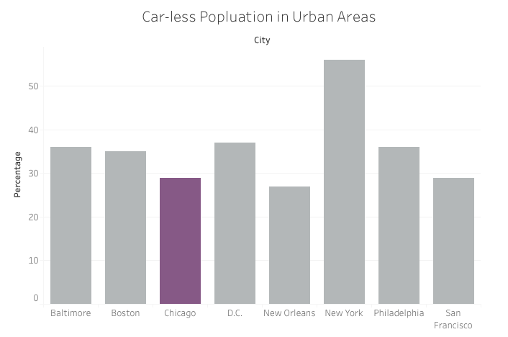
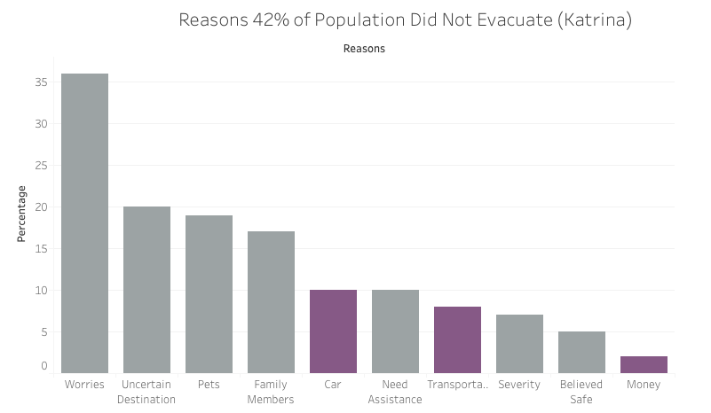
Is There Demand?
University of New Orleans Transportation Center, October 2008
Fritz Institute, April 2006
Notes:
Sun
Average % is 35%
http://www.uno.edu/cola/planning-and-urban-studies/docs/Car-lessEvacuationPlanning.pdf
Sheltering is most effective
http://www.fritzinstitute.org/PPTs/FI-Harris_Katrina_0506.pdf

Slide 5
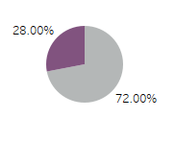
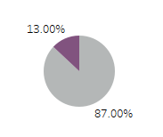

How much Demand?
900,000 Car-less People
30,000 Ubers
120,000 Car-Less People Evacuated
Number of Uber drivers: Crain’s Chicago, May 2016
Car-less Households of Chicago: University of Michigan, Jan 2014
Notes:
Steff
30,000 ubers→ 120,000 people served, 1 mil households in chicago, 28% Car-less → 334,000 households without cars, 900,000 people no access to cars → 13% of Car-less people can be rescued, 4% of entire population
Elderly
Low Income
Homeless
Families and Children
Handicapped

Slide 6
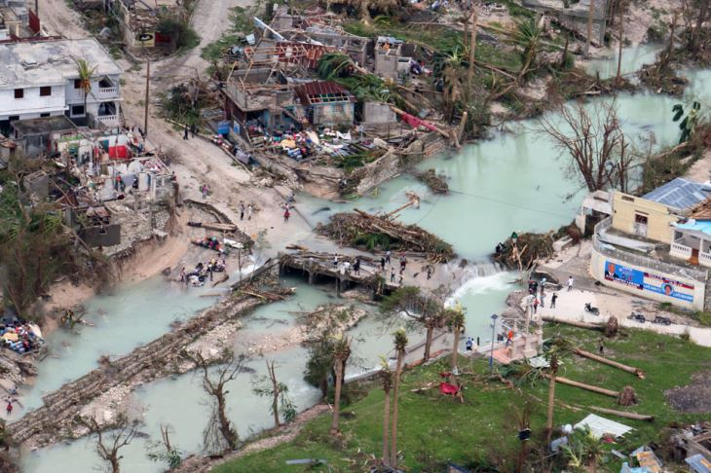
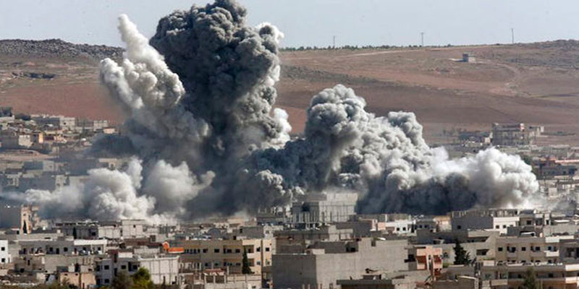
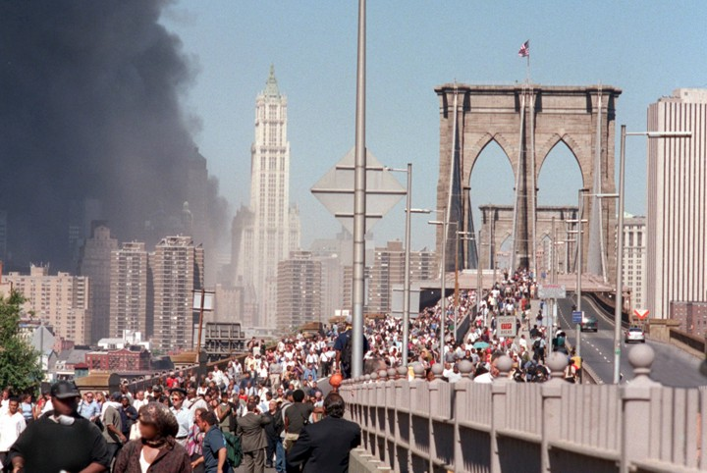
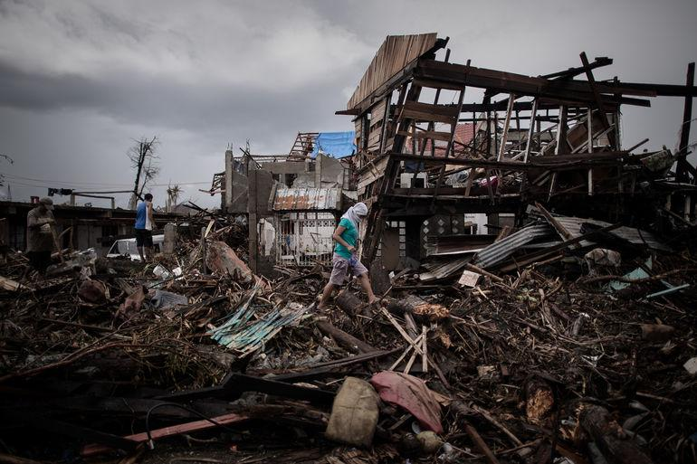
Uber During/Immediately After the Disaster?
NO.
PRO | Additional transportation resources, coordinate traffic
CON | unreliable infrastructure and technology, volunteer safety, liability, increase traffic

Slide 7
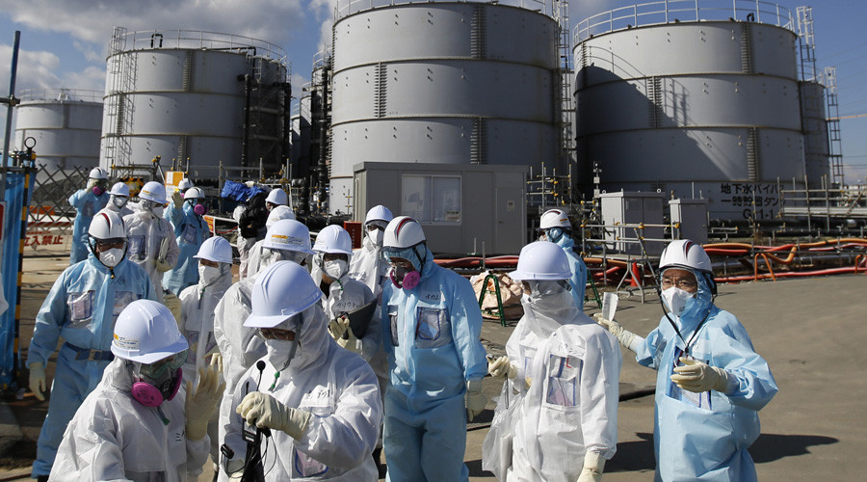
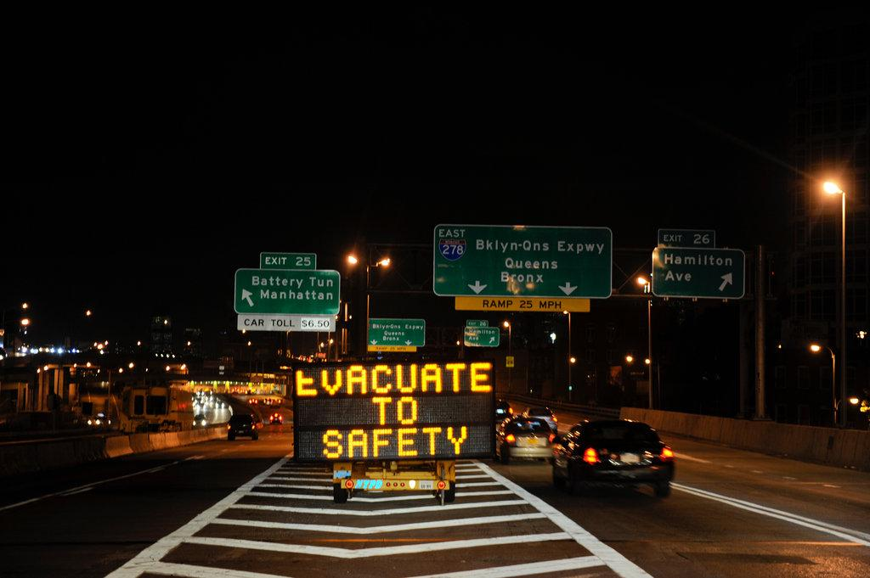
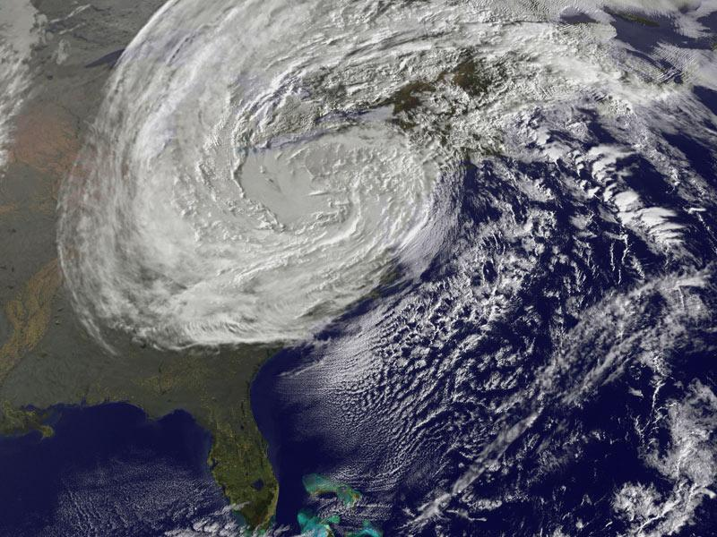
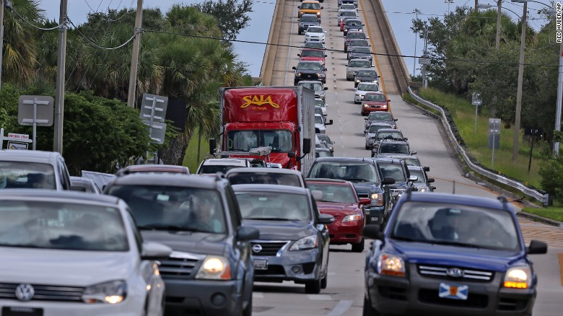
Uber Before the Disaster?
YES.
PRO | additional evacuation resource, coordinated traffic, accountability
CON | increase traffic

Slide 8



Where Should Uber Pick People Up?
1. Schools
2. Churches
3. Community Centers
Chicago Innovation, October 2015
Government Technology: Emergency Management, April 2011
Notes:
Heller
http://www.govtech.com/em/disaster/Diverse-Vulnerable-Populations-Preparedness-041111.html
Importance of using community and faith based organizations in order to coordinate emergency preparedness
Community Buildings (Churches, Schools, Community Centers)
→ Schools equipped to handle cars coming in
Schools have WiFi: http://chicagoinno.streetwise.co/2015/10/20/wifi-in-cps-chicago-public-schools-adding-wifi-to-all-schools-by-2016/
Can we find schools that are equipped to handle large flows of traffic.

Slide 9
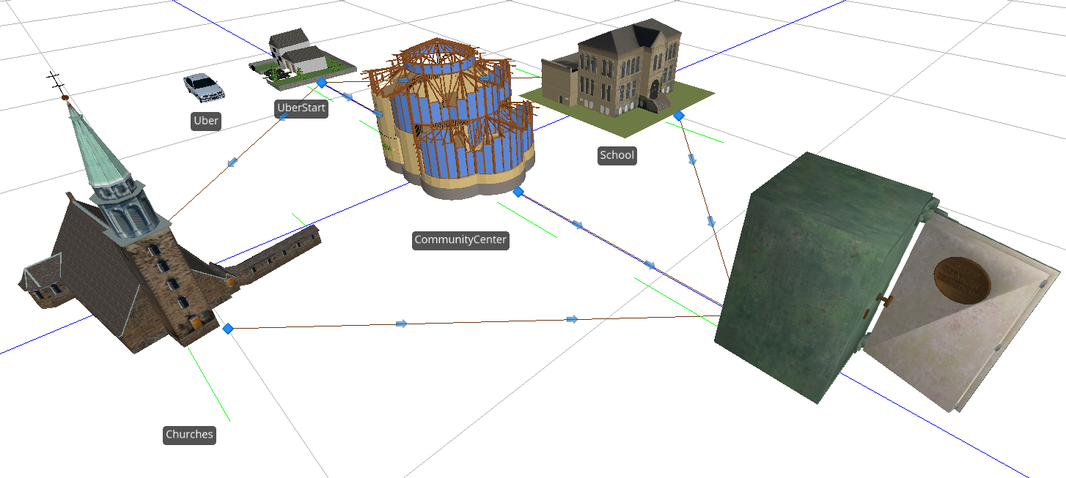
Simulation
Number Processed:
Schools:
1,845
Churches:
1,881
Community Centers:
1,786
Notes:
Schools: high capacity, low processing time
CC: vice versa
Church: sweet spot

Slide 10
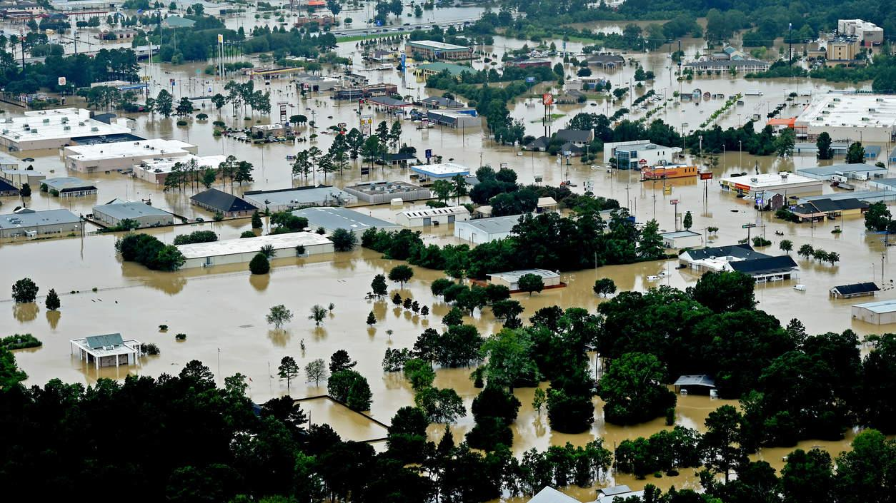
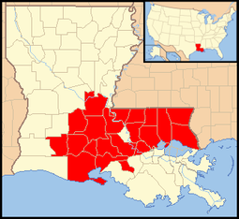
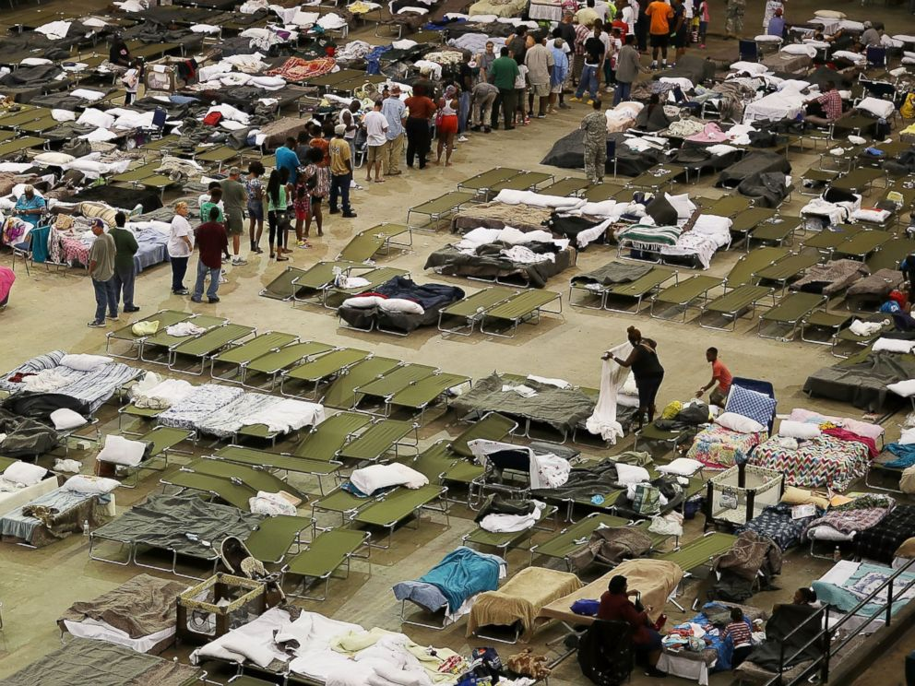
Where Should Uber Drop People Off?
During the 2016 Louisiana floods, Uber partnered with the American Red Cross and provided discounted rides to shelters within the area.
Uber Newsroom, August 2016
Notes:
https://newsroom.uber.com/us-louisiana/uber-supports-louisiana-flood-recovery-efforts-in-partnership-with-the-american-red-cross/
Evacuation Zones/Buildings
Shelters:
Louisiana evacuation offered ride credit to passengers going to shelter locations
→ shelters also good for vulnerable populations

Slide 11
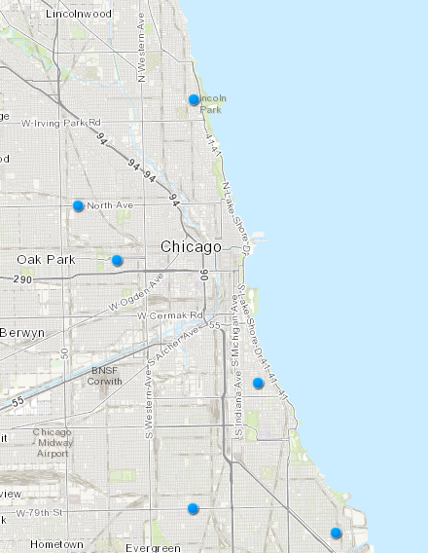
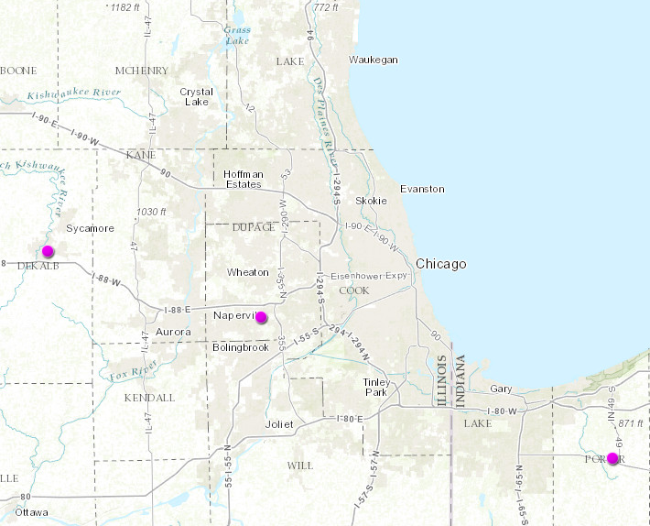
Where Should Uber Drop People Off?
Community Centers
Notes:
https://data.cityofchicago.org/Health-Human-Services/Community-Service-Centers-Map/tyd3-k85v
Evacuation Zones/Buildings
Shelters:
Louisiana evacuation offered ride credit to passengers going to shelter locations
→ shelters also good for vulnerable populations
During the 2016 Louisiana floods, Uber partnered with the American Red Cross and provided discounted rides to shelters within the area.
Valparaiso University, Benedictine University and Northern Illinois University
http://chicago.cbslocal.com/2014/09/30/safety-officials-prepare-for-evacuation-of-chicago-if-disaster-hits/

Slide 12



Training
Medical Training
Disaster Psychology
Local Resources
FEMA: Community Emergency Response Team Basic Training Instructor Guide, February 2016
Airbnb Disaster Relief Program
Notes:
Sun
FEMA Community Emergency Response Team has a 12 part training.
Basic Medical Training: CPR, identify life threatening need 911
Disaster Psychology: Physiological and Physical Effects of Trauma, Empathetic Listening
Local Resources: Alert and Warning Systems; location of different centers with resources, some community centers have different languages spoken
http://www.emergencyfirstresponse.com/emergency-first-response-courses/
https://www.fema.gov/media-library/assets/documents/27368
Jewish Coalition: Emergency management where each person has systematic way to deal with emergencies
Uber Push Notification
Messages from community centers, government, etc. all noting that uber will be providing free transportation at some time from a specified location

Slide 13

Thanks!
Notes:
UberXL:
-Accommodate wheelchair passengers
-Pets possibly
Flexibility of Location Dropoff
-Elderly!! ( 71% of people who died over 60 in Katrina; 47% over the age of 75)
Even if they have cars they are reluctant to use them
-Low income!
-Homeless
Babies

Slide 14
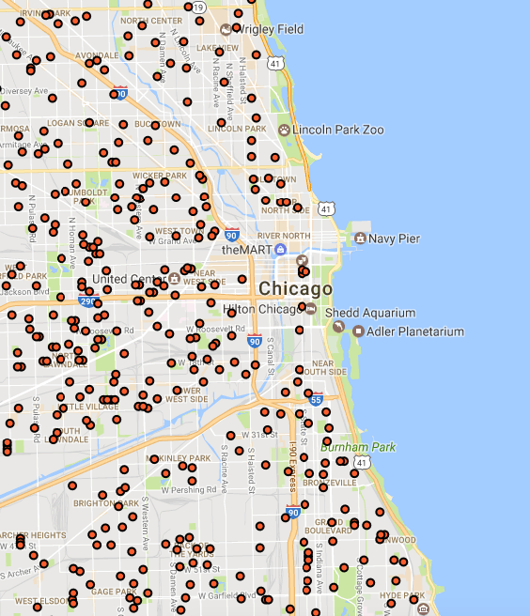
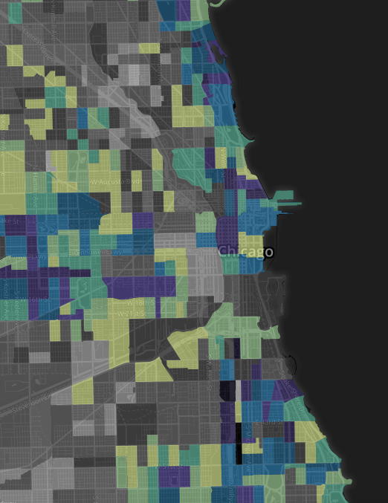
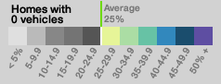
Appendix A: Geographic Concentrations
Low Car Ownership Neighborhoods
Neighborhoods near public transit
The Loop
Low Income Neighborhoods
East Side Chicago
http://transitized.com/commute/#11/41.9523/-87.0474
https://data.cityofchicago.org/Education/Chicago-Public-Schools-School-Locations-SY1415/3fhj-xtn5
Notes:
Steff
http://transitized.com/commute/#11/41.9523/-87.0474
https://data.cityofchicago.org/Education/Chicago-Public-Schools-School-Locations-SY1415/3fhj-xtn5

Slide 15



Appendix B: Uber’s Incentive
Political
Notes:
Political incentive for corporate Uber to “donate” Uber drivers’ times to this given their current negative publicity

